Slide 1
Employer Reporting of Health Coverage
Presented BY:
Carly Clukey, SPHR

Slide 2
Code Sections 6055 & 6056
The Affordable Care Act (ACA) created new reporting requirements under Internal Revenue Code Sections 6055 and 6056.
Applicable Large Employers (ALE’s) must provide information to the IRS about the health plan coverage they offer (or don’t offer) to their employees.
Intended to provide government with information to administer other ACA mandates, such as the employer penalty and the individual mandate.

Slide 3
Code Sections 6055 & 6056
Under the Affordable Care Act, there are two laws that govern reporting: 26 U.S.C. 6055 and 26 U.S.C. 6056.
Section 6056 states: Every applicable large employer must meet the requirements of section 4980H, with respect to its full time employees during a calendar year and shall, at such time as the Secretary may prescribe, make a return as described in section(b). This is the Employer Mandate.
Section 6055 states: Every person who provides minimum essential coverage to an individual during a calendar year shall, at such time as the Secretary may prescribe, make a return described in subsection (b). The IRS is looking to see if the Individual Mandate is followed. Self-funded plans will also be required to provide additional information so the IRS can determine if the individual mandate is satisfied.

Slide 4
Reporting Penalty Relief
The IRS has stated that they will not impose penalties for 2015 returns and statements filed in 2016, provided reporting entities can show they have made a good faith effort to comply with the information reporting requirements.
This means you still must file on time and show you made an effort to get it right.
Penalties are $100.00 per form that are not submitted on time both to the individual and to the IRS.

Slide 5
Why the reporting?
Individual Mandate
Individual must have minimum essential coverage or pay a penalty of 2% of household income for 2015
Employer Mandate
Employer must offer affordable coverage that meets minimum value to substantially all employees.
If coverage is not offered: $2,000 penalty for every full-time employee (minus first 80 in 2015)
If coverage doesn’t meet MV or affordability: $3,000 penalty per full-time employee who receives a subsidy in the Exchange.

Slide 6
Who is an Applicable Large Employer?
ALE’s had an average of at least 50 full-time employees (including full-time equivalents) during the prior calendar year.
A full-time employee works on average at least 30 hours per week.
All other hours worked are added and combined by 120 to determine full-time equivalents.
EXAMPLE: A company has 35 full-time employees (30+ hours). In addition, the company has 20 part-time employees who all work 24 hours per week (96 hours per month). These part-time employees’ hours would be treated as equivalent to 16 full-time employees, based on the following calculation:
20 employees X 96 hours= 1920/120 = 16
This company would be considered an ALE, based on a total full-time equivalent count of 51. That is, 35 full-time employees plus 16 full-time equivalents based on part-time hours.
All employers with a common owner or that are otherwise related are combined and treated as a single employer for determining ALE status.

Slide 7
What needs to be filed?
1095-C: tells the IRS about the individual who has or who was offered coverage
Fully-Insured Employers: Parts 1 & 2
Self-Funded Employers: Parts 1, 2 & 3
Must be prepared for any employee who was a full-time employee (30+ hours/week) for any month during the calendar year.
1094-C: transmitted along with the 1095-C and is a cumulative report
Employers must transmit both 1094-C and 1095-C’s to the IRS and provide a 1095-C to each employee.

Slide 8
When must the forms be filed?
1095-C forms must be distributed to employees no later than February 1st, 2016.
Can be distributed at the same time as W-2.
1094-C forms must be postmarked by any employer who files manually by February 29, 2016
Only employers with less than 250 employees can file manually
1094-C forms must be filed electronically by March 31st, 2016
Employers with 250 or more employees must file electronically

Slide 9
1095-C

Slide 10
1095-C (Part 1)
Includes employee & employer information
Employer must provide a contact number in case the IRS or employee has questions.

Slide 11
1095-C (Part 2)
Outlines which months of the year the employee was offered coverage and which months the employee was enrolled
Determines whether the coverage is affordable and meets minimum value
For each calendar month, enter the applicable code. If the same code applies to all 12 months, enter the code in the “All 12 Months” box, and do not complete the individual months.

Slide 12
Safe Harbors for Calculating Affordability
Always based on Employee-Only Coverage
Three safe-harbors to determine affordability
Cost of coverage cannot exceed 9.5 % of an employees salary. For example, for an employee making $35,000 per year, coverage would be affordable if less than $277.08 per month.
Cost of coverage cannot exceed 9.5% of the Federal Poverty Guidelines. For 2015, Federal Poverty Guideline for an individual is $11,770. Coverage must be less than $93.18 per month to be affordable.
Cost of coverage cannot exceed 9.5% of the employees rate of pay at the time he was offered benefits.

Slide 13
1095-C (Part 2 Line #14)
1A. Qualifying Offer: Minimum essential coverage providing minimum value offered to full-time employee with employee contribution for self-only coverage equal to or less than 9.5% federal poverty line and at least minimum essential coverage offered to spouse and dependent(s).
1B. Minimum essential coverage providing minimum value offered to employee only.
1C. Minimum essential coverage providing minimum value offered to employee and at least minimum essential coverage offered to dependent(s) (not spouse).
1D. Minimum essential coverage providing minimum value offered to employee and at least minimum essential coverage offered to spouse (not dependent(s)).
1E. Minimum essential coverage providing minimum value offered to employee and at least minimum essential coverage offered to dependent(s) and spouse.
1F. Minimum essential coverage NOT providing minimum value offered to employee, or employee and spouse or dependent(s), or employee, spouse and dependents.
1G. Offer of coverage to employee who was not a full-time employee for any month of the calendar year and who enrolled in self-insured coverage for one or more months of the calendar year.
1H. No offer of coverage (employee not offered any health coverage or employee offered coverage that is not minimum essential coverage).
1I. Qualifying Offer Transition Relief 2015: Employee (and spouse or dependents) received no offer of coverage, received an offer that is not a qualifying offer, or received a qualifying offer for less than 12 months.

Slide 14
1095-C (Part 2 Line #15)
Complete line 15 only if code 1B, 1C, 1D or 1E is entered on Line #14
Enter the amount of the Employee-Only share of the lowest-cost monthly premium for the plan that provides minimum essential coverage and meets minimum value.
The employee may have elected to “buy-up” to a different plan or include dependents on their policy. Therefore, Line #15 isn’t necessarily what the employee is paying for health insurance.
If the employer pays 100% of the premium, enter “0.00”; do not leave blank.

Slide 15
1095-C (Part 2 Line #16)
2A: If employee was not employed on any day of month.
2B: If employee is not a full time employee.
2C: If employee was enrolled in coverage for any month. **
2D: If the employee is in a limited non-assessment period.
2E: If for any month in which the multi-employer interim guidance applies.
2F: If the employer used the section 4980H Form W-2 safe harbor to determine affordability.
2G: If the employer used the section 4980H federal poverty line safe harbor to determine affordability.
2H: If the employer used the section 4980H rate of pay safe 4980H(b)

Slide 16
2C
/
Life 14: Code 1E used if using W-2 to measure affordability
Line 15: Enter cost of Employee-Only coverage of lowest cost plan
Line 16: 2F corresponds with Code 1E and outlines that you are using W-2 to measure affordability. However, if employee enrolled in coverage, always use Code 2C, even if others apply.

Slide 17
2C
/
Life 14: Code 1A used if offered Employee Only coverage that was no more than 9.5% of the Federal Poverty Guidelines, or less than $93.76 for 2015
Do not need to complete Line 15 if Code 1A is used
Line 16: 2G corresponds with Code 1A and outlines that you are using Federal Poverty Guidelines to measure affordability. However, if employee enrolled in coverage, always use Code 2C, even if others apply.

Slide 18
Employee hired on 5/18/15 and has a waiting period of 1st of the month following 60 days. Employee was offered coverage effective 8/1/15, using the W-2 safe harbor. Employee waived coverage from 8/1/15 – 12/31/15.
Life 14:
1H: No offer of coverage (Jan – July)
1E: Coverage offered to employee, spouse and dependents
Line 16:
2A: Not an employee any day of the month (Jan – April)
2D: In a limited non-assessment period (May – July)
2F: Coverage offered where cost didn’t exceed 9.5% of W-2

Slide 19
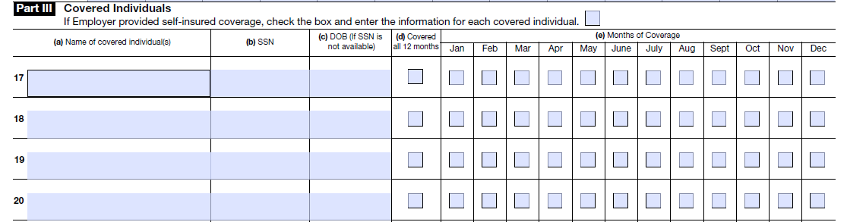
1095-C (Part 3)
Applicable Large Employers who are self-insured must complete Part 3 to include all employees and covered dependents.
DOB only required if SSN is blank.

Slide 20
1094-C

Slide 21
What is Transition Relief?
On Feb. 10, 2014, the U.S. Treasury released final regulations implementing the ACA’s employer shared responsibility provisions. The final regulations include a number of new transition rules in 2015 that apply for certain types of employers.
To avoid a payment for failing to offer health coverage in 2015, ALEs with 100 or more employees will need to offer coverage to 70 percent (vs. 95%) of their full-time employees.
The final regulations also include a one-year delay for medium-sized employers that satisfy certain eligibility conditions. In 2015, the ACA's employer shared responsibility provisions will generally apply to larger firms with 100 or more full-time employees. Employers with 50-99 full-time employees will have to comply starting in 2016.

Slide 22
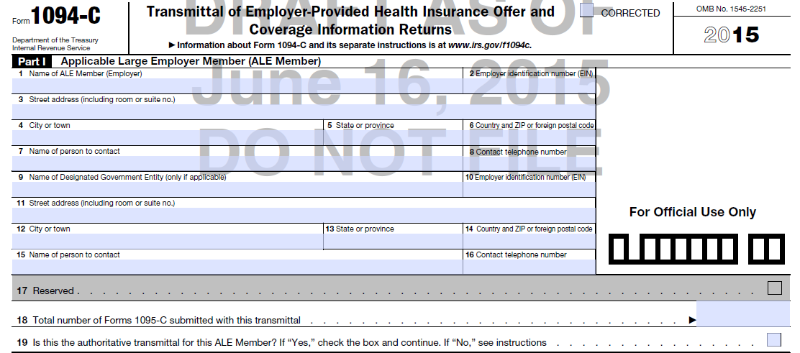
1094-C (Part 1)
Must provide contact name and number.
For control groups, one employer will submit Authoritative Transmittal for entire group.
Only required for DGE’s

Slide 23
1094-C (Part 2)
Line 21: You are an Aggregated Group if multiple Tax ID’s are being filed for.
Line 22:
If Qualifying Offer Method or Qualifying Offer Method Transition Relief checked, employer can provide employees statement that includes information from 1095-C in lieu of 1095-C. However, 1095-C’s must still be provided to IRS. (Not available if self-funded)
98% Offer Method can be used if coverage was offered to 98% of ALL employees.
Section 4980H Transition Relief can be used if you are using any Transition Relief (50-99 Transition Relief or 100+ using 70% offer of coverage Transition Relief)

Slide 24
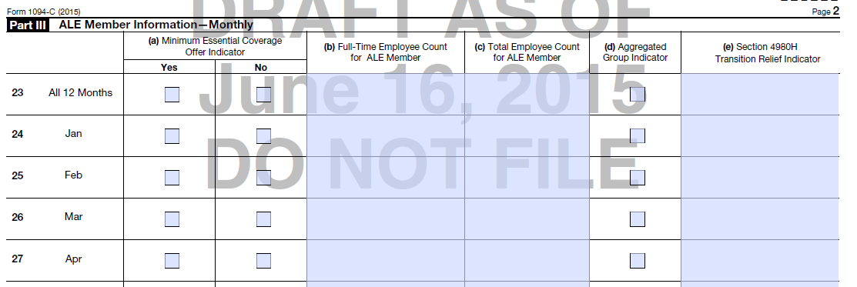
1094-C (Part 3)
Was coverage offered to 95% of employees? (If offered to 70%, still check Yes, and complete column E)
Full-Time employee count only includes those working 30+ hours per week and eligible for benefits (new hires in waiting period not included)
Includes all employees that worked that month. Must use the same day of the month for each month.
If employer checked Section 4980H Transition Relief in Line 22, enter Code A for the 50 to 99 Relief, or enter Code B for the 100 or More Relief.

Slide 25
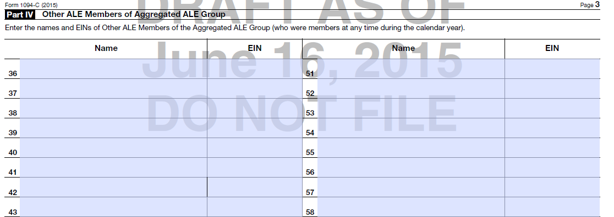
1094-C (Part 4)
If part of an Aggregated Group, must list all other members of the group, in order of highest to lowest employee count.

Slide 26
Questions?

Slide 27
Wellness Program Rules and Allowances
Under the affordable care act

Slide 28
Wellness Under ACA Basics
Final regulations issued June 3, 2014. Proposed changes in comment period.
HIPAA nondiscrimination rules prohibit a group health plan from discriminating against an individual based on a health factor, except in two circumstances
(1) if the discrimination is in favor of an individual with an adverse health status
(2) a wellness program that meets the requirements of the HIPAA wellness rules (5 total)
Applies to group health plans and health insurance issuers providing group policies
Includes grandfathered plans
For years starting on or after January 1, 2014
Notes:
Penalties could include up to $100 a day under the Internal Revenue Code and Public Health Service Act
Also subject to enforcement actions under ERISA
What follows is a two-step approach to evaluate your wellness programs under the new final rules

Slide 29
STEP 1: Participatory or Health Contingent?
PARTICIPATORY WELLNESS PROGRAMS
None of the Conditions to Obtain Reward Based on Individual Satisfying Standard Related to a Health Factor
Not Required to Meet 5 Requirements of HIPAA Wellness Rules
Examples: Reimburse fitness center membership cost, reward or reimbursement for smoking cessation program, regardless of whether employee quits smoking, reward for attending monthly, no-cost health education seminar, reward to complete health risk assessment without further action required by employee (educational or otherwise) with regard to identified health issues
Notes:
Step one to the process is determining if your program is Participatory or Health Contingent.
CLICK (to show animation)
Note on the slide it says that with a participatory program, employers are not required to meet the 5 requirements of HIPAA Wellness Rules. HOWEVER, you do have to ensure that your program is offered to all “similarly situatuated individuals” such as all FT employees or those on the medical plan, etc. Employers can set their own program eligibility.

Slide 30
STEP 1: Participatory or Health Contingent?
HEALTH-CONTINGENT PROGRAMS
Requires an individual to satisfy a standard related to a health factor in order to obtain a reward
Required to Meet 5 Requirements of HIPAA Wellness Rules
TWO TYPES OF HEALTH CONTINGENT PROGRAMS
(1) ACTIVITY BASED--Requires individual to perform or complete an activity related to health factor to obtain reward, but does not require individual to attain or maintain specific health outcome
Examples: Walking programs where some individuals may have difficulty participating due to a health factor, such as asthma or pregnancy
(2) OUTCOMES BASED--Requires individual to attain or maintain specific health outcome in order to obtain reward
Examples: Reward for not smoking, biometric screening that tests for risk factors (e.g., high cholesterol, high glucose level) and provides reward to individuals within healthy range, while requiring individuals outside health range or at risk to take additional steps to obtain same reward, such as to meet with health coach
Notes:
These types of programs are more robust, and have more regulatory concerns.
CLICK (to show animation) then read line on slide…
CLICK (to show animation) and read examples of each type of program.

Slide 31
STEP 2: If Health-Contingent Must Comply with 5 Requirements
#1 ANNUAL QUALIFICATION
 | Health-Contingent Wellness Programs
 | Activity-Based | Outcome-Based
#1 Annual Qualification | Must give individuals opportunity to qualify for the reward at least once per year | Same
Notes:
I will quickly address the 5 rules that are associated with health-contingent wellness programs…

Slide 32
STEP 2: If Health-Contingent Must Comply with 5 Requirements
#2 LIMIT ON AMOUNT OF REWARD
 | Health-Contingent Wellness Programs
 | Activity-Based | Outcome-Based
#2 Limit on Amount of Reward | Non-Tobacco Programs (e.g. BMI, cholesterol) – Limit is up to 30% of cost of coverage Tobacco Programs – Limit is up to 50% of cost of coverage Examples of Permitted Percentages: 30% reward for BMI + 20% for tobacco use – Meets Limit 10% reward for BMI + 40% for tobacco use – Meets Limit 0% for BMI = 50 % for tobacco use – Meets Limit 30% for BMI + 50% for tobacco use – Not Allowed (only allowed up to 50% total when include tobacco) reward at least once per year | Same

Slide 33
STEP 2: If Health-Contingent Must Comply with 5 Requirements
#2 LIMIT ON AMOUNT OF REWARD CONT’D
Must not exceed the cost of employee-only coverage under the plan, includes employee and employer contributions
Allow a 30% limit for non-tobacco wellness program rewards plus an additional 20% for tobacco wellness programs (so up to 50% total if including tobacco programs)
The regulations define “reward” to include both obtaining a reward, such as a premium discount, or avoiding a penalty, such as absence of a premium surcharge

Slide 34
STEP 2: If Health-Contingent Must Comply with 5 Requirements
#3 REASONABLE DESIGN
 | Health-Contingent Wellness Programs
 | Activity-Based | Outcome-Based
#3 Reasonable Design | Must be reasonably designed to promote health or prevent disease Program will satisfy standard if has reasonable chance of improving health or preventing disease, is not overly burdensome, is not a subterfuge for discrimination based on a health factor, and is not highly suspect in the method chosen to promote health or prevent disease Based on all relevant facts and circumstances | Same (but additional rules related to Reasonable Alternative below)
Notes:
An example of a program that is not reasonably designed: A tobacco surcharge that does not offer any programming to support employees in changing their behavior (such as a cessation class).

Slide 35
STEP 2: If Health-Contingent Must Comply with 5 Requirements
#4 REASONABLE ALTERNATIVE
 | Health-Contingent Wellness Programs
 | Activity-Based | Outcome-Based
#4 Reasonable Alternative | Medical Reasonable Alternative Only Must provide alternative for individuals for whom it is unreasonable difficult due to a medical condition to satisfy standard or medically inadvisable to attempt to satisfy standard | Reasonable Alternative Required for All Alternative required regardless of medical condition for “any individual” who does not meet the initial standard
Doctor’s Note Allowed? | Yes – if reasonable under circumstances, plan may seek verification from individual’s personal physician that health factor makes it unreasonably difficult or medically inadvisable to satisfy Activity-Based wellness program. | No – since alternative for Outcome-Based standards must be provided to all who fail test (regardless of health reason).
Notes:
Activity-Based Program Example (if asked): If Activity-based standard is to run 3 miles, and individual has medical reason cannot run, may set alternative as Activity-Based standard of walking twice a week. If individual also cannot walk due to medical reasons, would need third alternative
Outcome-Based Example: If standard is BMI, then an alternative is setting a BMI standard that is easier to reach, must give realistic time to reach, such as within year. Individual then earns same reward as if met initial standard (so plan may need to pay reward retroactively).

Slide 36
STEP 2: If Health-Contingent Must Comply with 5 Requirements
#5 NOTICE OF REASONABLE ALTERNATIVE
 | Health-Contingent Wellness Programs
 | Activity-Based | Outcome-Based
#5 Notice of Reasonable Alternative | Must disclose in all plan materials describing wellness program the availability of reasonable alternative to earn reward or waiver of standard Must include contact information and statement that recommendations of individual’s personal physician will be accommodated | Same Also must include in any disclosure to individual that he or she did not satisfy Outcome-Based standard (such as in screening results)

Slide 37
Other Potential Legal Concerns
The American with Disabilities Act (ADA)
The Genetic Information Nondiscrimination Act (GINA)
The Fair Labor Standards Act (FLSA)
Title VII of the Civil Rights Act
The Employee Retirement Income Security Act (ERISA)
Health Savings Accounts
Health Reimbursement Accounts
Notes:
In addition to the concerns with the ACA, here are a few additional Wellness Program Concerns. We have a seven-page compliance checklist that we use to walk our clients through each of these areas. If you have concerns or would like additional information on any or all of the above, feel free to see me after the presentation.

Slide 38
Reference and Disclaimer
Tinnes, C. A. (2013). Agencies Issue Final HIPAA Wellness Program Rules under ACA. National Financial Partners Corp.
You must not rely on the above information as an alternative to legal advice from your attorney or other professional legal services provider. If you have any specific questions about any legal matter you should consult your attorney or other professional legal services provider. You should never delay seeking legal advice, disregard legal advice, or commence or discontinue any legal action because of information provided herein.
Need an attorney? We recommend Constangy, Brooks & Smith, LLP, One Federal Place, Suite 900, 1819 Fifth Avenue North, Birmingham, AL 35203, Phone: 205.252.9321

Slide 39
Questions?
Carly Clukey
904-461-1800
cclukey@mbaileygroup.com

